Slide 1
From the subjective to the objective: Can we measure an apple’s bitterness?
By: Ethan Scott & Daniel Girvitz

Slide 2
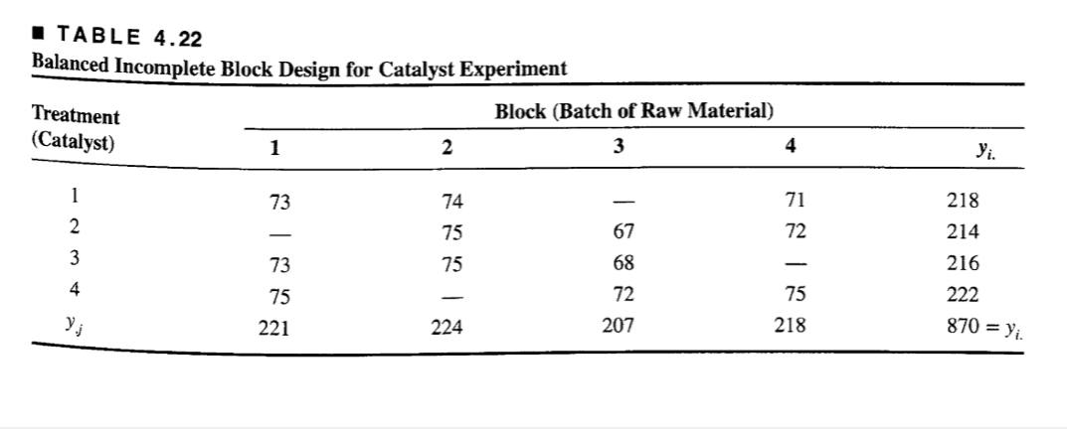
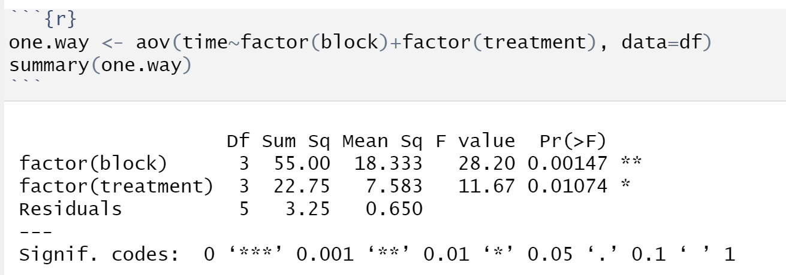
Preliminary on balanced incomplete block designs (BIBDs)
Notes:
As the ANOVA table matches Table 4.24, the 'aov' function analyzes a BIBD properly, and so we can use it.

Slide 3
Background
20 tasters (blocks) assessed 3 out of 4 different varieties of apples (treatments)
Tasters are labeled a-t and apples are labeled 298, 493, 649 and 937
The tasters then had to then rank the taste of these apples based on their aftertaste from 0 (strong dislike) to 150 (strong like)
The experiment was conducted as a balanced incomplete block design

Slide 4
Hypothesis
H0: Equality of treatment means for the aftertaste of the apples
Ha: Inequality between at least two of the means of the aftertaste

Slide 5
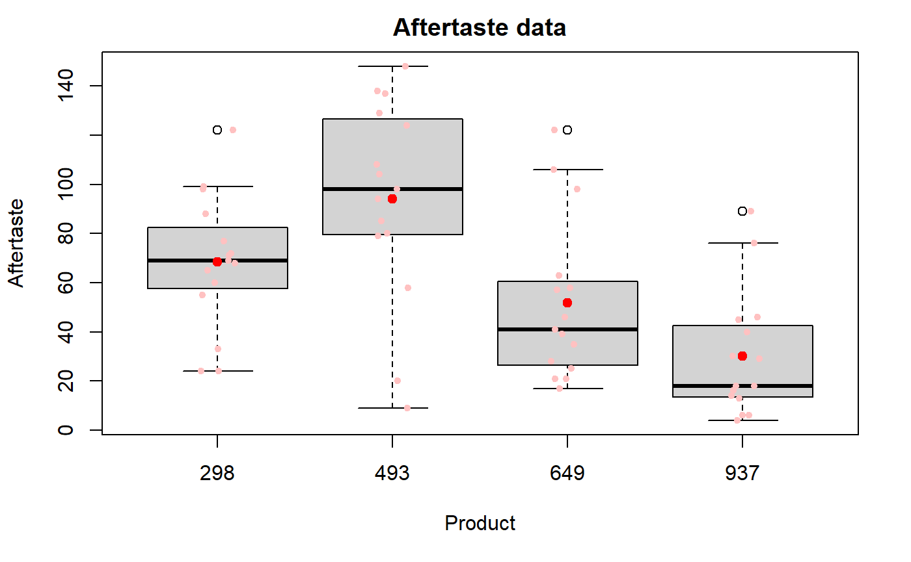
Boxplots
Notes:
From the boxplots, one can see product 493 appears to be the sweetest (with the greatest mean and corresponding percentiles), although it has a long lower wisker, which extends past products 298 & 649. The rest are relatively more bitter; as regards their differences, that is TBD.

Slide 6
ANOVA Assumptions
Data are i.i.d normally distributed
Homogenity of variance among treatments (in our case, aftertaste values of apple products), which is called homoscedasticity, which is not to be pronounced…
Balanced design

Slide 7
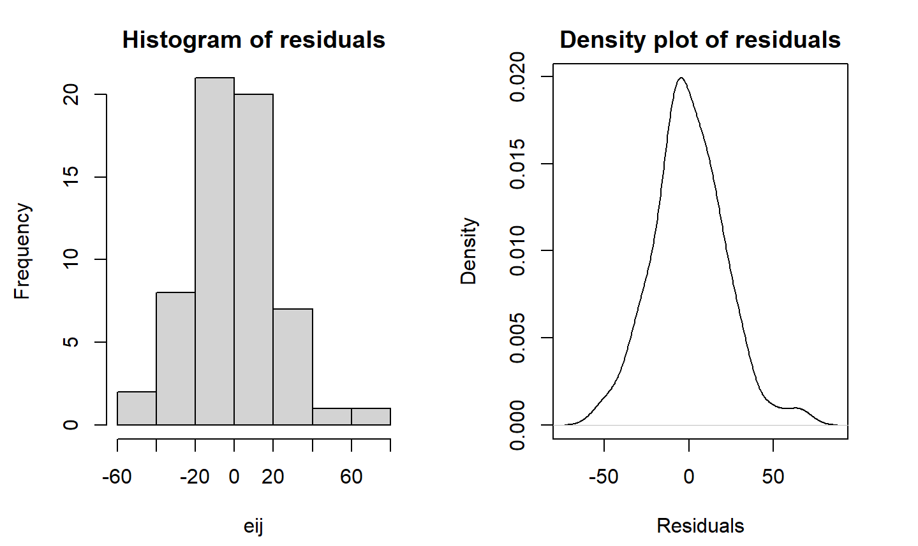
Plots of Residuals
Ethan begins here

Slide 8
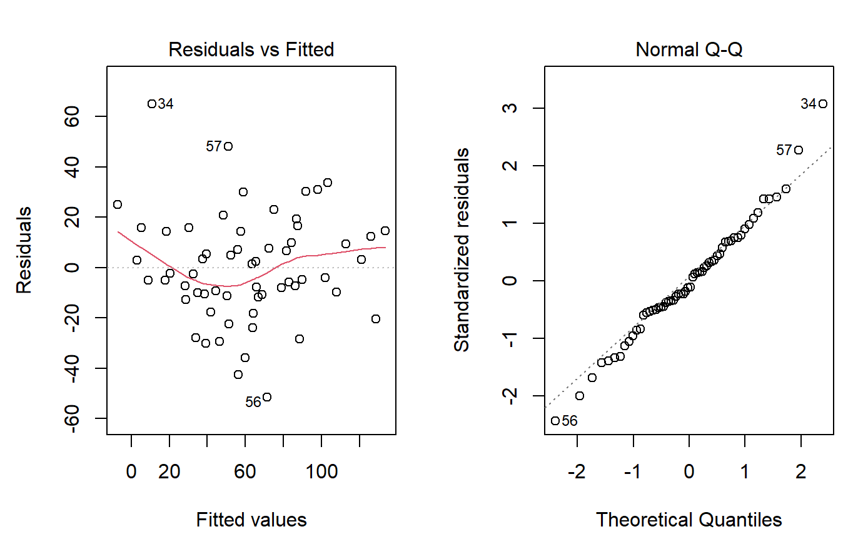
Diagnostic Plots
Notes:
\textbf{The Residuals vs Fitted plot:} Residuals are randomly distributed with what appears to be constant width, thus, we can conclude the homogenity of variance (homoscedasticity) requirement is satisfied. Although there is a curve to the red line, we choose to ignore it, as it is quite minor. A Box-Cox transformation may correct this slight deviation. \newline
\textbf{Normal Q-Q:} Theoretical quantities fit the diagonal very well, which intersects the origin. Thus, the normality requirement is satisfied. But, just to be sure, let's check the residuals. \newline

Slide 9
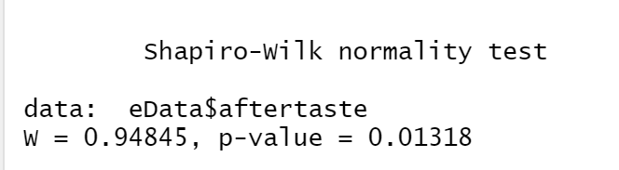
Shapiro-Wilk Test
Notes:
From the pvalue we can conclude that the data is normally distributed

Slide 10
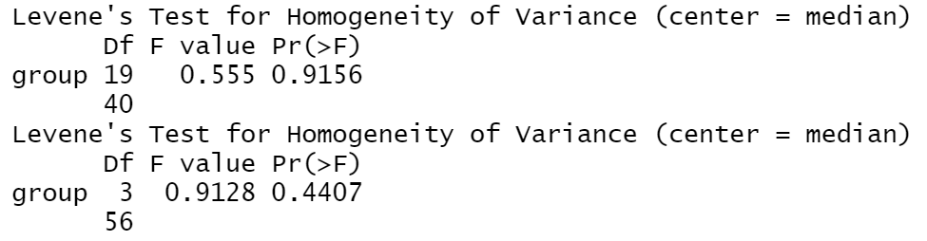
Levene’s Test
Notes:
Looking at both p-values we can conclude that our data also has equal variances

Slide 11
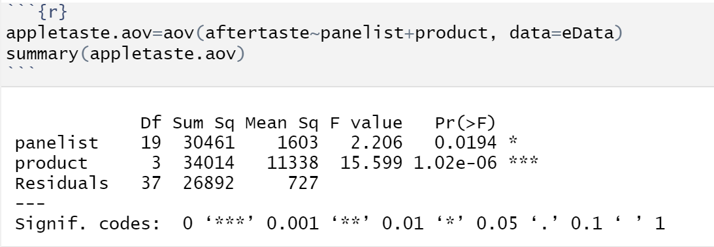
ANOVA
Notes:
Obviously, the null hypothesis of equality of treatment means, holding a level of alpha=0.05, must be REJECTED.

Slide 12
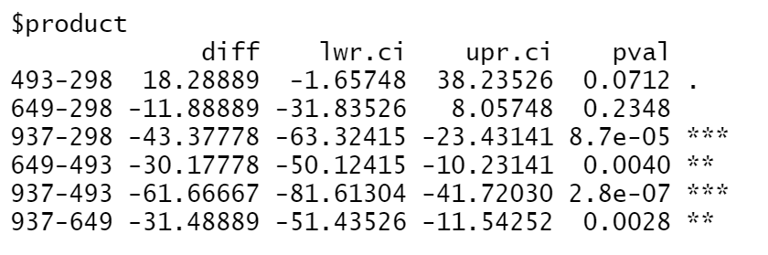
Fisher LSD Test for difference of Means

Slide 13
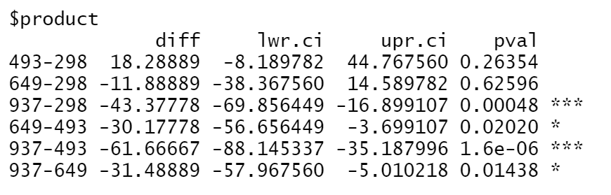
Tukey’s Test for difference of means

Slide 14
Conclusion
Reject H0 in favour of Ha
Conclude that there is a significant difference in the taste of at least 2 of the varieties of apples

